Slide 1

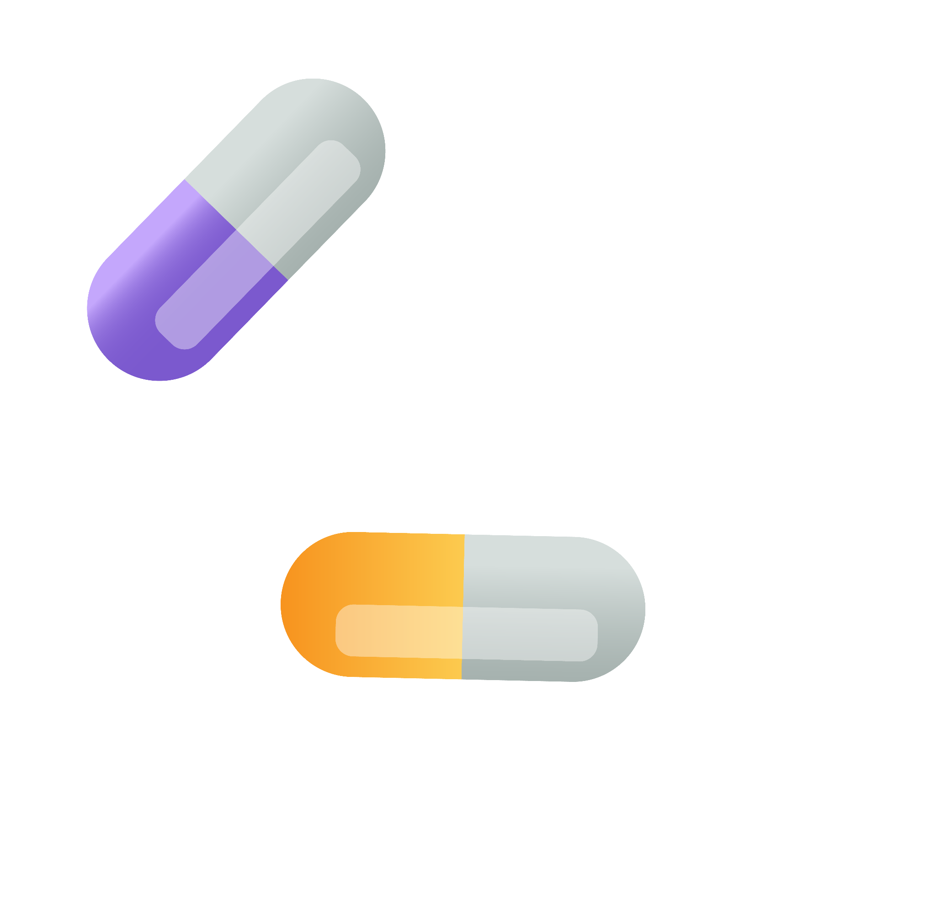
ASCLEPIUS
Parkinson's Disease

Slide 2
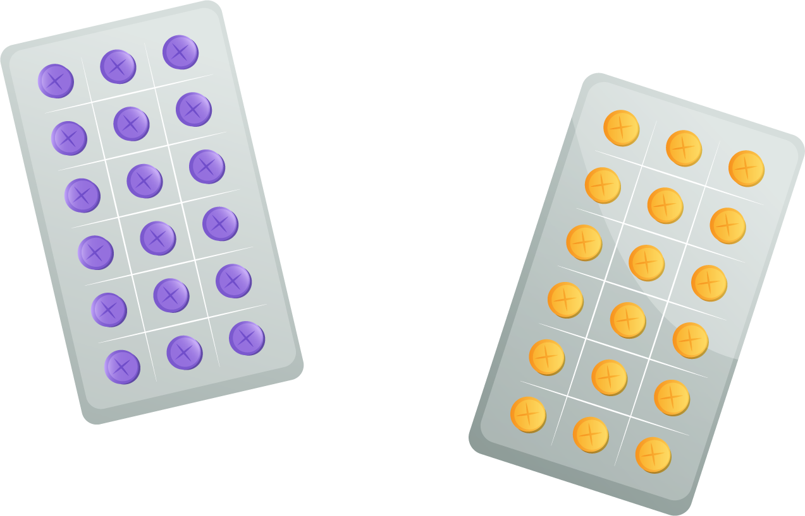
Table of contents
Name
01
Colour
02
Logo
03
Slogan
04
What does Asclepius word refer to?
Gray- Why gray colour?
What does our logo refer to?
From Pain medicine has been Found.
05
Poster
Brochure
06

Slide 3
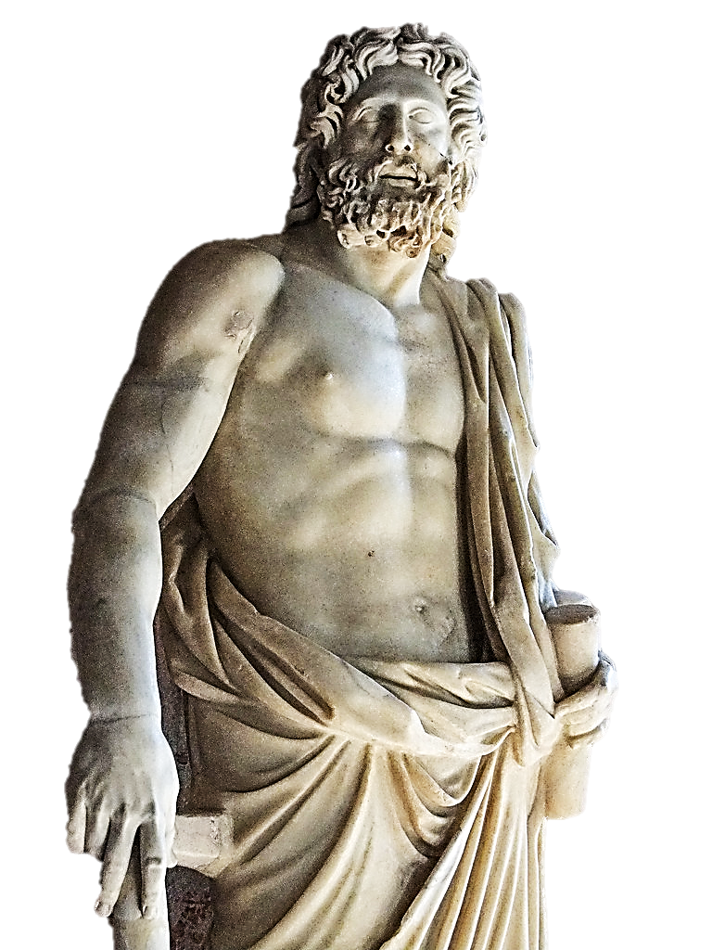


01
Name
ASCLEPIUS
It refers to the name of Greek god of medicine and healing (Ἀσκληπιός). His name is associated with health, medical knowledge and the art of healing.

Slide 4
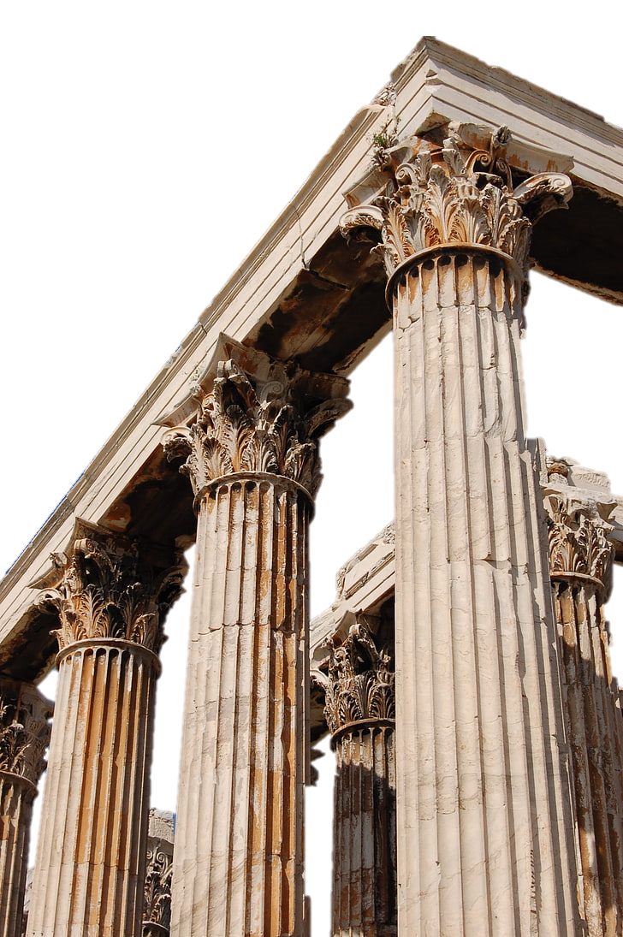

02
Colour
Gray
The color gray is associated with ancient Greek civilization.

Slide 5
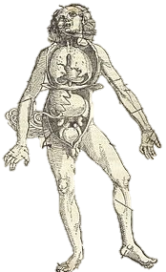
03
Logo
It refers to rod of Asclepius.

Slide 6
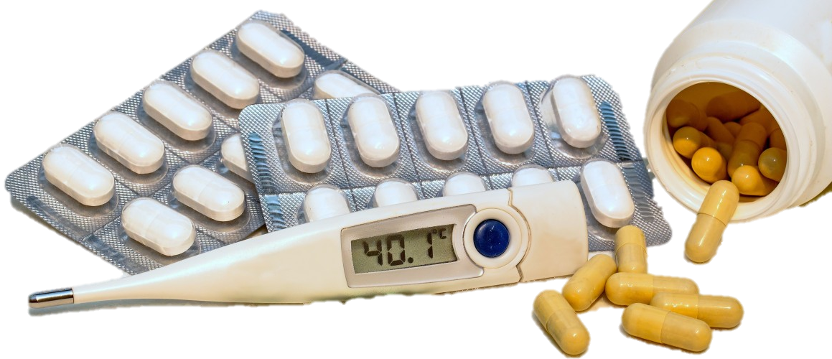
04
Slogan
"From Pain Medicine has been Found "
Ἐκ τοῦ ἄλγους ἰατρική εὕρηται.

Slide 7






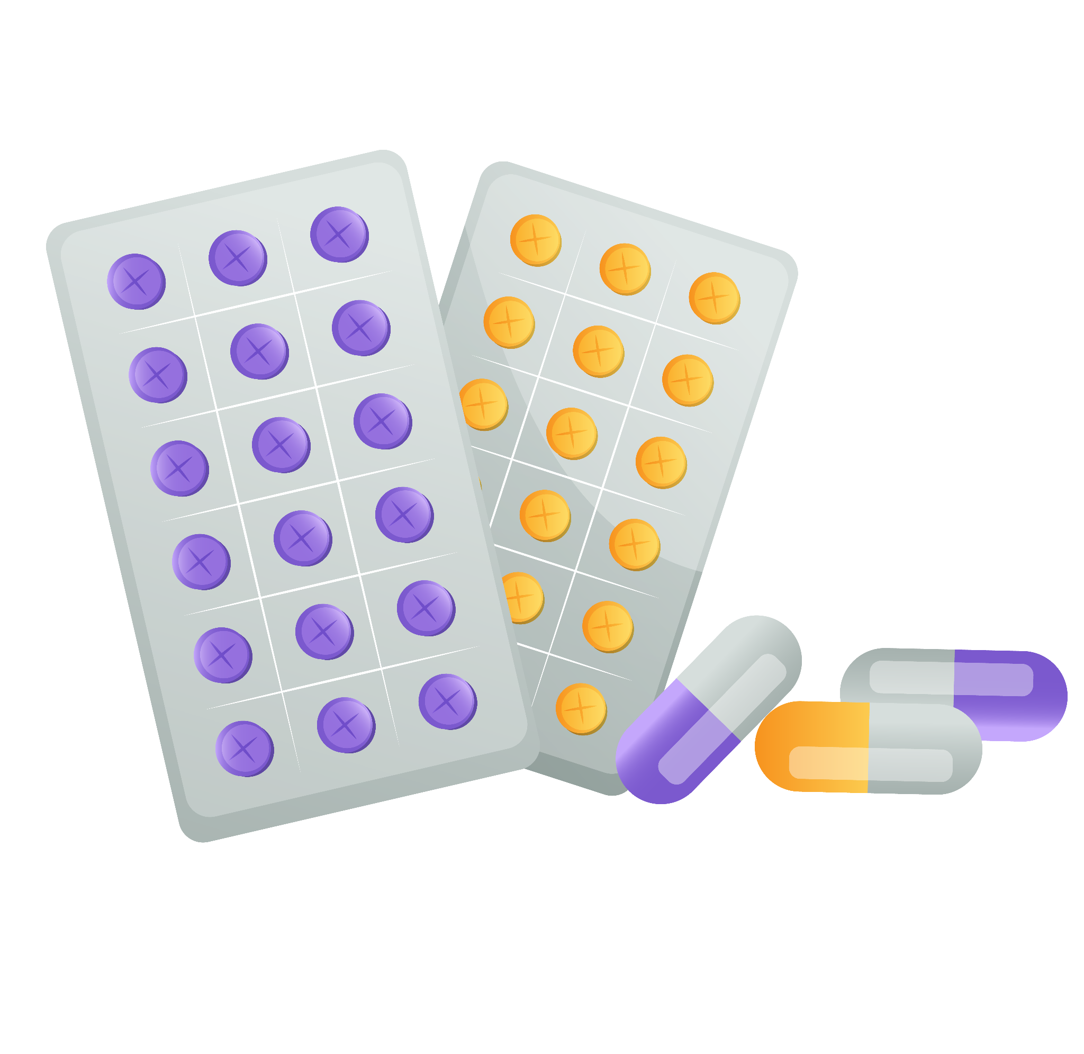
05
Poster
Abstract
Introduction
Materials
Method
Results
Conclusion

Slide 8

Abstract
Parkinson’s disease is caused by the loss of dopaminergic neurons, and Safinamide helps by inhibiting MAO-B to prevent dopamine breakdown. Researchers used computational docking to modify Safinamide through fluorination, heterocycle additions, and structural changes to improve its binding affinity. Molecular docking with Auto Dock Vina and ligand modifications in Marvin Sketch identified compounds 7 and 8 as having superior affinity, while compound 2 performed the worst results. These findings suggest that Safinamide modifications could enhance treatment, warranting further experimental validation.

Slide 9

Introduction
Parkinson’s disease is a progressive neurodegenerative disorder caused by irreversible loss of dopaminergic neurons in the substantia nigra, leading to motor (bradykinesia, rigidity, tremors) and non-motor symptoms (depression, sleep issues, increased secretions). It results from genetic and environmental factors, including toxin exposure viruses, and certain drugs . While not fatal, its symptoms can contribute to death.
Safinamide, an approved treatment for mid-to-late-stage Parkinson’s, acts as a selective MAO-B inhibitor and dopamine reuptake inhibitor to maintain dopamine levels. It also blocks sodium channels and modifies calcium channels, enhancing cognitive function and protecting neurons. Recent advancements aim to improve its effectiveness.

Slide 10
Materials
1
3
Biovia Discovery Studio
Marvin Sketch
2
4
Auto dock Vina
Swissadme

Slide 11

Method
The Four modifications were sketched using Marvel Sketch:
The MAO-B receptor was obtained from the Protein Data Bank (PDB code: 2V5Z), with binding sites defined based on the recorded PDB data and prepared for molecular docking. Disordered conformations, crystals, and ligands were removed, and docking was performed using Auto Dock Vina, where higher scores indicated better molecular fitting to the protein. Compounds with lower scores were excluded. Pharmacokinetics, bioavailability, and drug-likeness of the bioactive compounds were analyzed using the SwissADME , followed by ADME calculations and molecular sketches.

Slide 12
Method
Compound | Modification
1 | Addition of fluorine at the meta position, the formation of a furanose ring, addition of chlorine to improve compatibility, and addition of a fluoropyrimidine moiety.
7 | Addition of trifluoromethyl at the meta position the formation of a tetrahydrofuran ring, addition of chlorine to improve compatibility, and addition of a 2, 6-difluoropyrimidine.
8 | Addition of fluorine at the meta position, the formation of a tetrahydrofuran ring, addition of chlorine to improve compatibility, and addition of a 2-fluoropyrimidine.
2 | The worst results,Adding2: Add a heterocycle (pyridine ring), add cl for better fit, and add the pyridine part.

Slide 13
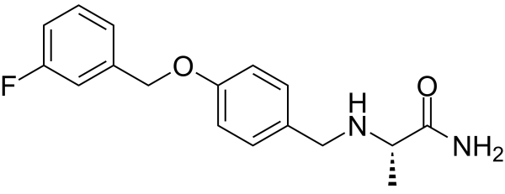
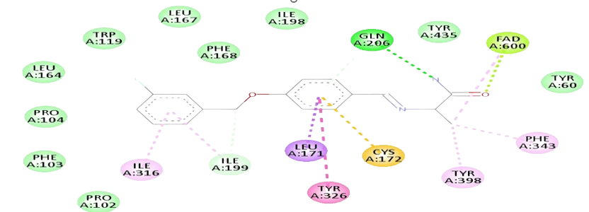

Results
SAF
-9.4

Slide 14
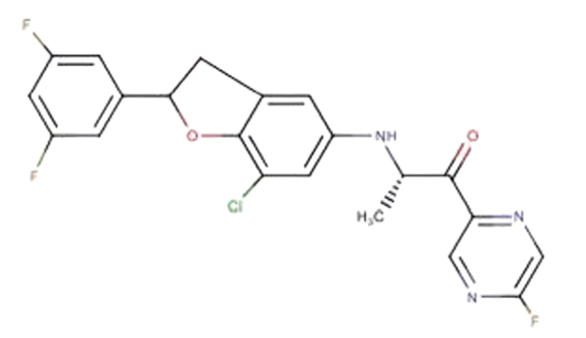
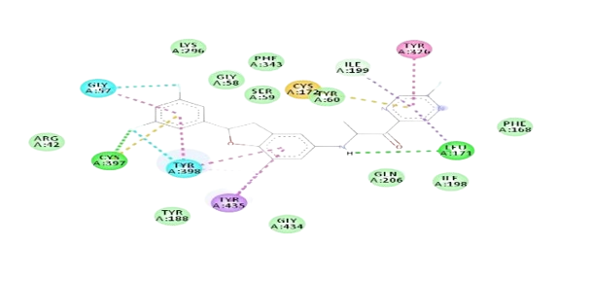
MOD 1
Results
-11.6

Slide 15
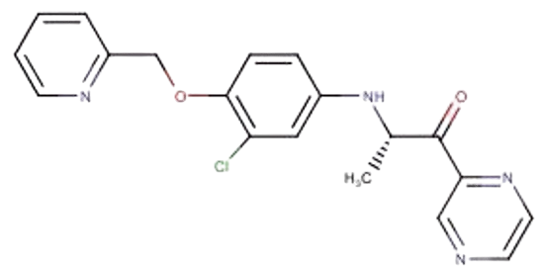
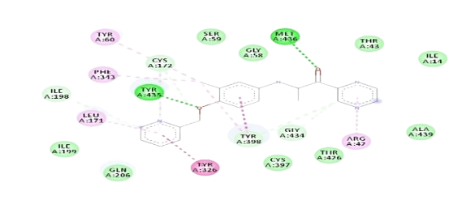
MOD 2
Results
-10.2

Slide 16
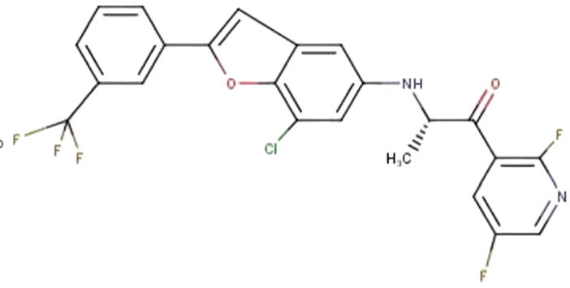
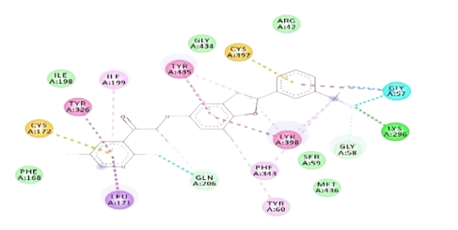
MOD 7
Results
-11.7

Slide 17
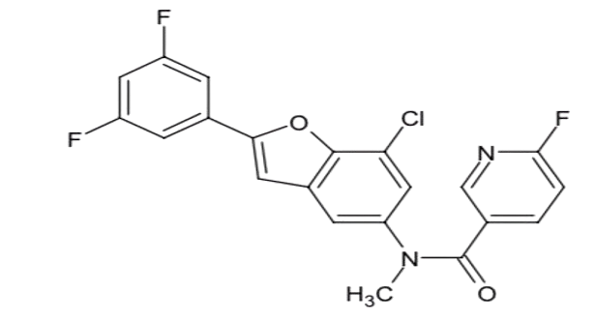
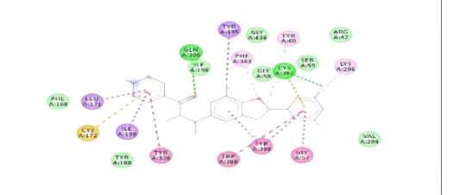
MOD 8
Results
-11.9

Slide 18
Results
Compound | Discussion
1 | We found that fluropyrimidine has made 4 extra interactions with (tyr326,ile,199,tyr60,leu171) van der waal,convention hydrogen,carbon hydrogen,pi-pi stacked,pi-pi t-shaped,amide-pi stacked bond interactions. After adding furanose and chloro on central benzene ring it mad interactions with (tyr435, tyr398) pi-pi stacked,pi-pi t-shaped , amide-pi stacked. After adding di fluro on meta positions interactions with lateral benzene were (tyr398, cys397, gly57 ) and 3-fluro interactions with (gly57)and 5-fluro with (cys397,tyr398 ) .
7 | We found that 2, 6-Difluoropyridine has made 4 extra interactions with (tyr326 pi-pi stacked/ T-shaped / amide-pi stacked, ile199 pi-alkyl, cys172 pi-sulfur, leu171 pi-sigma). After adding tetrahydrofuran and cl on central benzene ring it mad interactions with (tyr435 pi-pi stacked/ T-shaped / amide-pi stacked, tyr398 pi-pi stacked/ T-shaped / amide-pi stacked). After adding trifluoromethyl on meta positions interactions with lateral benzene were (tyr398 pi-pi stacked/ T-shaped / amide-pi stacked, lys296 conventional hydrogen bond, gly57 carbon hydrogen bond, gly58 carbon hydrogen bond) 2-fluro interactions with (gln206 carbon hydrogen bond).
8 | We found that 2-fluoropyridine has made 4 extra interactions with (leu171, cys172, ile199, tyr326) pi-sigma,pi-sulfur,pi-alkyl,pi-pi stacked,pi-pi t-shaped, amide-pi stacked interactions.After adding tetrahydro furan ring and chloro on central benzene ring it made interactions with (tyr60, tyr398, tyr435, phe343) pi-alkyl,pi-pi stacked,pi-pi t-shaped, amide-pi stacked,pi-alkyl interactions. After adding flur in meta position made interactions with(tyr398,typ388,gly57,lys296,cys397) pi-alkyl,pi-pi stacked,pi-pi t-shaped, amide-pi stacked,pi-alkyl,conventional hydrogen bond interactions.

Slide 19
Swissadme Results
Results
Molecule Number | Lipophilicity | Hydrophilicity | Absorption | Bioavailability | BBB | Beta Glycoprotein
Safinamide | Moderate Lipophilicity | Moderately Soluble | High | 0.55 | Yes | No
Modification 1 | High Lipophilicity | Poorly Soluble | High | 0.55 | Yes | Yes
Modification 2 | Moderate Lipophilicity | Poorly Soluble | High | 0.55 | Yes | No
Modification 7 | High Lipophilicity | Poorly Soluble | High | 0.55 | No | Yes
Modification 8 | Very High Lipophilicity | Poorly Soluble | High | 0.55 | No | Yes

Slide 20
Conclusion
After molecular docking, the binding affinities of the top five compounds were evaluated, with the reference ligand (SAF) showing a binding energy of -9.4 as a comparison. Among the tested ligands, MOD-1 (-11.6) exhibited better binding affinity than the reference, indicating a stronger interaction with the target protein. The best scoring compounds were Compound 8 and Compound 7, with Compound 8 showing the highest number of stabilizing interactions, including hydrogen bonding with key amino acids like TYR, CYS, GLY, ILE, and PHE, as well as hydrophobic and disulfide interactions. These interactions significantly affect the protein conformation. In conclusion the two best candidates for new modifications of Sulfonamide are Compound 8 and Compound 7.

Slide 21
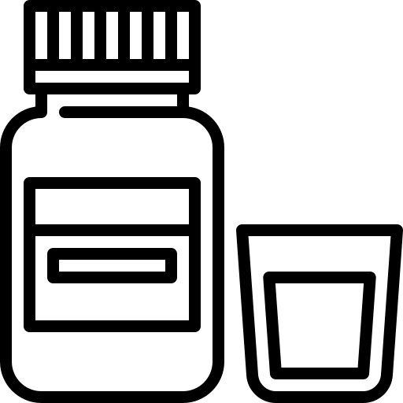


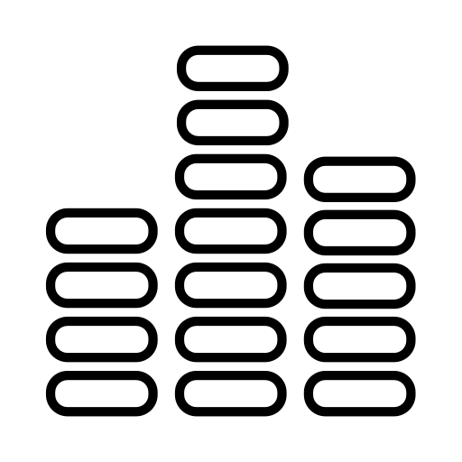


06
Brochure
NanoSuspension
Application
Advantage
Synthesis
Characteristic
Conclusion

Slide 22
Nanosuspension
Flurbiprofen (FB) is a BCS Class II drug with low water solubility, this study investigates the potential of FB nanosuspensions for dermal drug delivery to enhance solubility and bioavailability. FB nanosuspensions were formulated using Planta care 2000 (PL). A design of experiment (DoE) approach was employed to analyze critical formulation attributes (CFAs) and critical process parameters (CPPs). This brochure explores the advantages of applications and synthesis methods.

Slide 23



Application
Improved Dermal Permeation: The nanosuspension demonstrated higher permeability through rat skin than a conventional solution
Enhanced Solubility: Flurbiprofen nanosuspensions increased the drug's saturation solubility compared to coarse powder.
Reduce Side Effects: This formulation ensures stable drug delivery while minimizing systemic side effects compared to oral administration

Slide 24

Advantage
Enhanced Skin Penetration The smaller particle size and increased surface area allow for better drug accumulation in the skin, leading to higher penetration and improved bioavailability
Reduced Systemic Side Effects Targeted dermal delivery minimizes gastrointestinal and systemic side effects commonly associated with oral NSAIDs, making the treatment safer
Improved Permeation Studies show that flurbiprofen nanosuspensions have significantly higher permeability through the skin compared to conventional solutions, enhancing therapeutic effectiveness.

Slide 25


Synthesis
High-Pressure Homogenization reduces particle size by forcing a coarse drug suspension through a narrow gap under high pressure (100–1500 bar), using shear forces, cavitation, and impact to enhance uniformity and stability.
Solvent Evaporation The bottom-up method dissolves the drug in an organic solvent, emulsifies it in a stabilizer-containing aqueous phase, and evaporates the solvent to precipitate nano-sized drug particles

Slide 26
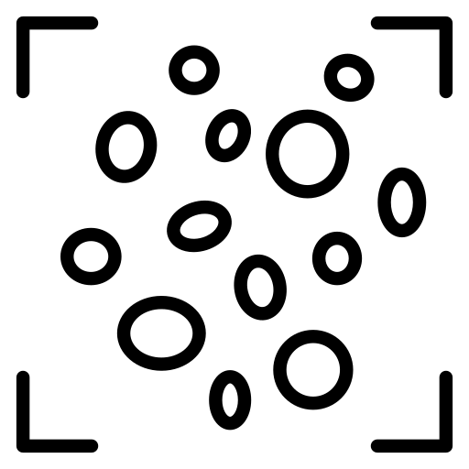


Characteristic
Particle Size, Distribution, and Zeta Potential Laser diffraction measured the PS and PDI of coarse FB powder and suspensions, while photon correlation spectroscopy analyzed nanosuspensions.
Differential scanning calorimetry (DSC) The melting point of FB and the possible polymorphic transformation of FB in the nanosuspensions were evaluated using DSC (Shimadzu DSC 60).
Scanning electron microscopy (SEM) SEM analyzed the morphology of FB coarse powder, physical mixture, and lyophilized nanosuspensions after gold palladium coating.

Slide 27

Conclusion
The study confirmed that the DoE approach effectively optimizes flurbiprofen nanosuspension, enhancing solubility, stability, and skin penetration, making it a promising system for topical applications.

Slide 28
BORD
Abdlurahman
Nour
Jana
Youstina
Kerolos
Members
Aliaa
Shady
Abdlurahman
Hebat Allah
Ahmed
Basma
Rahma
Yousouf

Slide 29


Thank You

